Slide 1
CHAPTER 5 Predictive Control with constraints 8 Invariant sets
Anthony Rossiter

Slide 2
Background
So far the constraint code and development has focussed on a simple GPC algorithm.
However, it was noted in chapter 4 that one is far better, in general, using a dual-mode approach for MPC which deploys infinite prediction horizons and an input prediction that converges asymptotically.
This video considers how constraint handling can be implemented over an infinite horizon while ensuring a finite computational load.
It utilises the concept of invariant sets.

Slide 3
Closed-loop MPC algorithm
Standard MPC objective
Decision variables are perturbations c_{k} to control trajectory
J is equivalent to:
Ideally c =0
Nominal behaviour

Slide 4
Predictions and the challenge
Using the model and compensator equations recursively, one can easily determine the following:
Predictions evolve over an infinite horizon and therefore comparing them against constraints may be a problem.

Slide 5
Typical constraints
Upper and lower limits on an input:
Upper and lower limits on input rates:
Upper and lower limits on an state/output (these would usually be soft constraints):
It is also possible to have mixed constraints, that is linking inputs at different samples and so on, however these videos will not cover that explicitly.

Slide 6
The challenge
Predictions evolve over an infinite horizon and therefore comparing them against constraints may be a problem.
We need a means of capturing the constraint satisfaction over an infinite horizon, but using a finite number of inequalities.
Fortunately, a mechanism for this was given by Gilbert et al in 1988 and is summarised next.
We will begin with a simple example to demonstrate the concepts.

Slide 7
Constraints over a long horizon
Let the dynamics be given as:
Let the constraints be given as:
This implies:
How far ahead do we need to predict?

Slide 8
Key concept
Establish that ensuring:
implies:
If this is the case, then we can represent constraints over an infinite horizon using just predictions over a horizon of ‘n’.
Assuming transition matrix ‘A’ has strictly stable poles, then we know a suitable ‘n’ must exist because:

Slide 9
Determining required horizon
Let the inequalities be given for a specified horizon ‘n’:
Try and find a value ‘x’ which violates constraints at ‘n+1’ but satisfies constraints earlier on.
If we cannot force a violation, then ‘n’ is large enough.
If we can, increase n and try again.

Slide 10
Reminder of key point
Assumed that the asymptotic value of the state is strictly inside the constraints and not on the boundary.
We used the origin as the asymptotic point and assumed constraints were strictly negative and positive to ensure this.
Where the origin is not the asymptotic point, one may need to use deviation variables to show an equivalent relationship and thus result exists.

Slide 11
Simplifying the set
Assume one has found ‘n’ so that the constraint satisfaction over an infinite horizon can be ensured by:
There may still be many unneeded inequalities in this set.
In general one could remove (off line) so called ‘redundant’ constraints to reduce the number of inequalities stored and used in the QP.
The MATLAB code does not do this for simplicity.
It is needed for high dimensions.

Slide 12
Invariant and admissible sets
The set is called invariant because:
Using set notation, this may be clearer:
Called MAXIMAL ADMISSIBLE SET because it is the largest set such that x_{k} satisfies constraints, for all k.
Membership of this set is both necessary and sufficient to satisfy constraints.

Slide 13
Summary Objectives
Express predictions in the form:
Express constraints in the form:
After which MAS result is automatic.
Next we show some MATLAB code for determining these MAXIMAL ADMISSIBLE SETS (MAS).
Ensure initial set is closed as the code is not robust.

Slide 14
MATLAB code
Main file is called findmas.m (in constraints folder). [F,t] = findmas(A,G,f)
This file is simple (not robust) so assumes that the initial set is bounded so one cannot satisfy this with an unbounded value for x_{k}.
The viewer can easily edit to tackle this should they need to.
KEY EXAMPLES ARE IN video5_8_example1.m and video5_8_example2.m
Boundedness is logical in general and one could add large upper/lower limits on states if necessary to ensure this.

Slide 15
video5_8_example1.m SISO
As there is only one state, the MAS reduces to an extremely simple form.
Initial condition here and state evolution satisfies constraints.
MAS same as original constraints (obvious).

Slide 16
video5_8_example2.m MIMO
The MAS has 32 inequalities.
MAS much smaller than original constraint.
Initial conditions on boundary of sample instant constraints, go on to violate those constraints
Note how MAS well inside sample constraints.

Slide 17
Summary
This video has shown how constraint satisfaction for predictions can be tested over an infinite horizon using a finite number of inequalities.
It is essential that the prediction dynamic is strictly convergent.
It is also necessary that the asymptotic values are strictly inside the sample constraints, that is not on a boundary.
The invariant set defined by these inequalities is sometimes called MAS for maximal admissible set.
The next video shows how this result is applied to OMPC/SOMPC and gives the relevant MATLAB code.

Slide 18



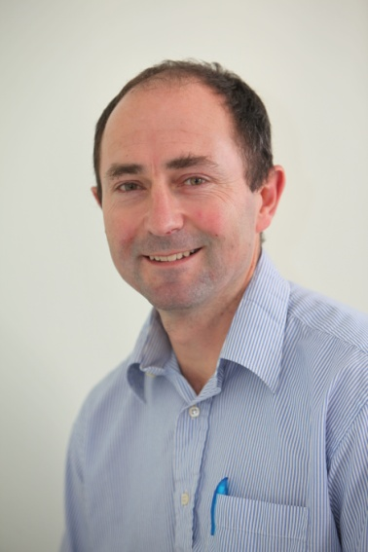
Anthony Rossiter
Department of Automatic Control and Systems Engineering
University of Sheffield
www.shef.ac.uk/acse
© 2014 University of Sheffield
This work is licensed under the Creative Commons Attribution 2.0 UK: England & Wales Licence. To view a copy of this licence, visit http://creativecommons.org/licenses/by/2.0/uk/ or send a letter to: Creative Commons, 171 Second Street, Suite 300, San Francisco, California 94105, USA.
It should be noted that some of the materials contained within this resource are subject to third party rights and any copyright notices must remain with these materials in the event of reuse or repurposing.
If there are third party images within the resource please do not remove or alter any of the copyright notices or website details shown below the image.
(Please list details of the third party rights contained within this work.
If you include your institutions logo on the cover please include reference to the fact that it is a trade mark and all copyright in that image is reserved.)

